Slide 1

Smart Lost and Found using QR Codes
A Modern Solution for Retrieving Lost Items
Shia Shafi (12) ,Yasir Amin (18) ,Suzain Farooq (11) ,Kamran Gulzar (16)

Slide 2

Introduction
Losing personal items like wallets, keys, ID cards, and gadgets is common in public spaces.
Traditional lost-and-found systems are slow, manual, and often unreliable.
We wanted a solution that is quick, contactless, and smart.
Hence, we built a QR-code based system that allows finders to directly notify owners.

Slide 3
Objective
To create a smart and accessible system that helps people retrieve lost belongings using QR codes.
To reduce dependence on physical lost-and-found desks.
To build a prototype that is scalable and can later be enhanced with mobile app support and AI integration.

Slide 4

Methodology Overview
We followed a simple but systematic process:
Research Phase – Studied existing systems, user behavior, and QR tech.
Design Phase – Mapped how QR scanning should lead to contact between finder and owner.
Development Phase – Built and tested the QR-based system using Google Forms and Sheets.
Testing Phase – Simulated real-world usage with peer feedback.
Documentation – Recorded our results and suggestions for future improvements.

Slide 5
System Architecture
Frontend:
Item with QR code label (printed)
Finder scans the QR using any phone.
Automatically redirects to a Google Form.
Backend:
The Google Form stores submissions in a connected Google Sheet.
Admin can access responses through Google Sheet for tracking.

Slide 6
How the System Works
Owner registers their item on a simple webpage/form.
A unique QR code is generated and printed.
QR code is attached to the item (e.g. on the back of a phone case, wallet, or ID card).
If the item is lost and someone finds it, they:
Scan the QR.
Are redirected to a form like:
“This item belongs to a student. Please help return it.”
Finder fills in their name, contact, and location found.
Owner (or admin) receives the data and connects with the finder.

Slide 7

Frontend Implementation Details
We used custom messages in the form to maintain anonymity and privacy.
The form includes fields like:
Finder’s Name
Contact Number (Optional)
Description of where the item was found
Item type (selected from dropdown)
QR codes were generated using a custom Python script using the qrcode library.

Slide 8

Backend Implementation Details
Form responses are automatically stored in Google Sheets.
Email notifications to inform the item owner instantly.
Response timestamps help in tracking patterns (e.g., common areas where items are lost).
Stimulation of a database by organizing items and responses in labeled sheets
The backend QR generation was integrated with Python, which auto-generates a QR code for each item registration. The script embeds the Google Form URL dynamically and saves the QR code as an image file.

Slide 9

Research and Validation
We surveyed 20+ students and staff at the university.
85% had lost something in the last 6 months.
70% said they found returning items difficult due to lack of identification.
We studied existing digital L&F apps but found them:
Too complex
Not anonymous
Dependent on app installs
This validated that our QR + Form approach is the most accessible.

Slide 10
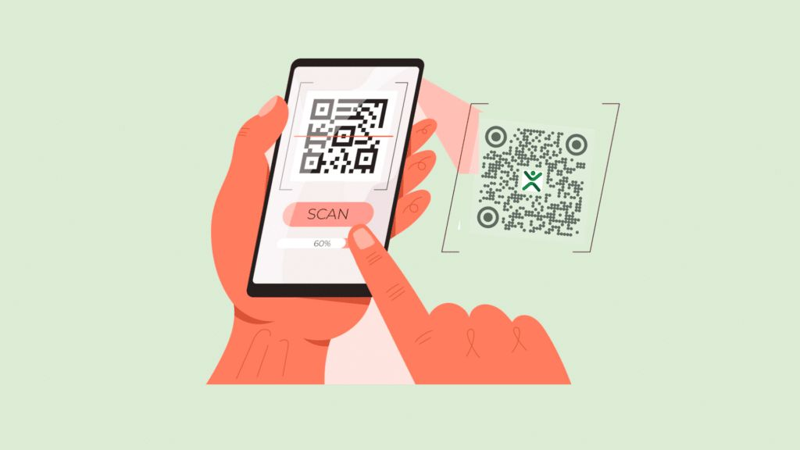
Benefits of Our System
Easy to use with any smartphone
Quick notification without involving third parties
No cost to implement (Google services are free)
Can be integrated with student/employee ID systems
Fully digital and eco-friendly

Slide 11

Real-life Applications
Colleges/Schools – Lost ID cards, USB drives, calculators
Airports/Stations – Luggage tags, passport covers
Offices – Employee laptops, access cards
Events – Badges, volunteer items

Slide 12

Challenges Faced
Making QR codes unique but still anonymous
Ensuring privacy for both owner and finder
Explaining to users how scanning leads to helpful action
Relying on internet connectivity (for scanning/forms)

Slide 13


Future Enhancements
Mobile app integration with push notifications
OTP-based secure owner verification
AI suggestions for most-lost zones on campus
Auto-generated return instructions
Central cloud database for large organizations

Slide 14

Conclusion
Our system is simple, scalable, and effective for solving everyday problems.
It blends technology and human kindness to create a smarter way to return lost items.
With further development, this can become a campus-wide or even city-wide solution.

Slide 15
Thank You
Questions and Feedback Welcome!

